Slide 1
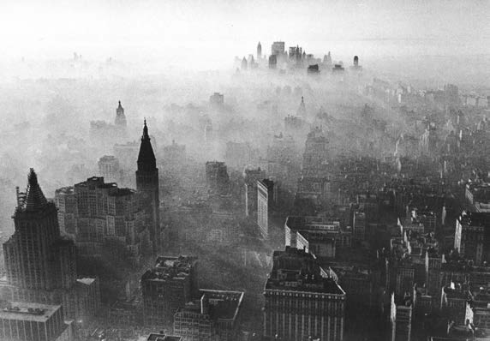
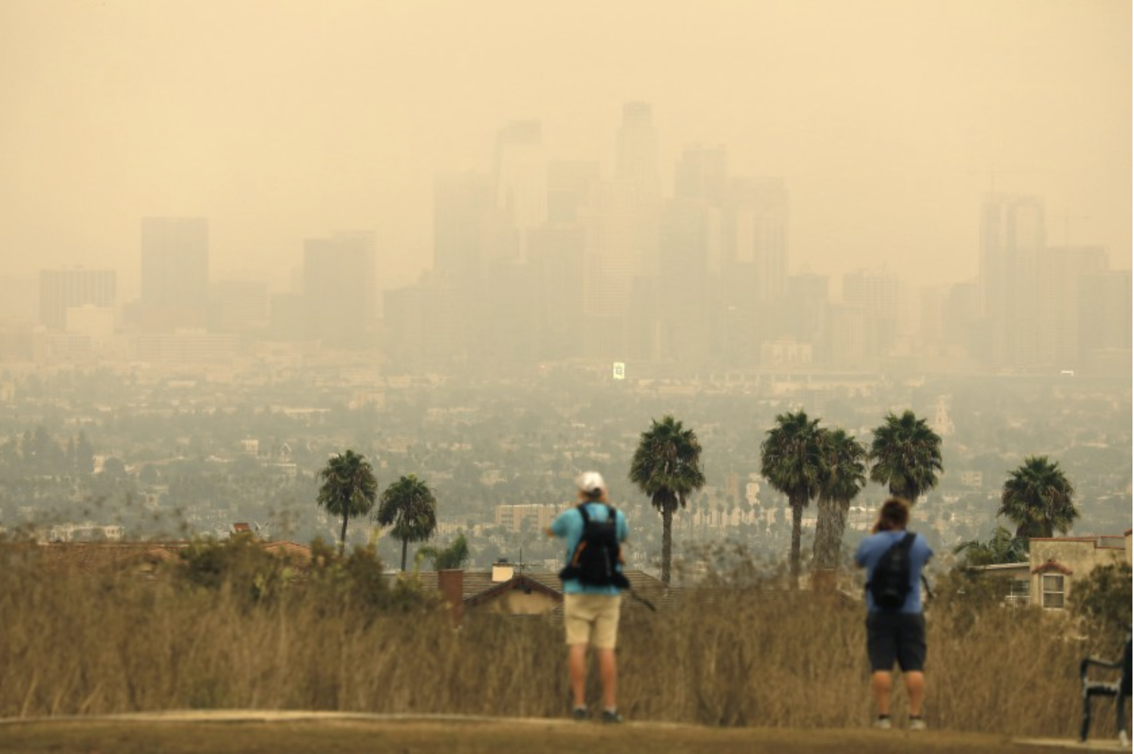
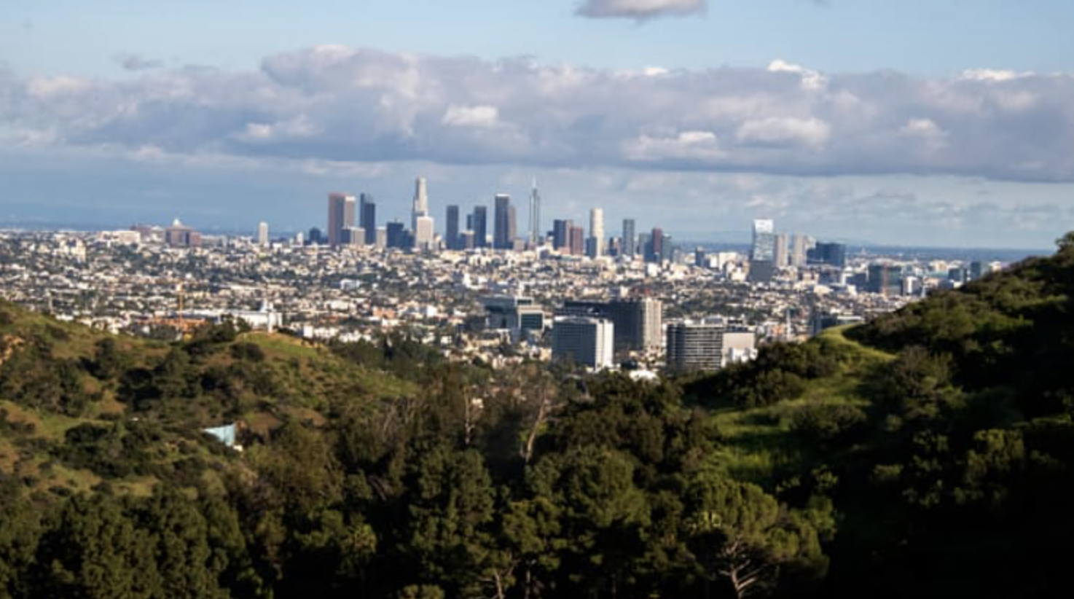
U.S. Air Quality Management
Evaluating a Half-Century of Progress
Your name here
Vision Air Consulting
Former Associate Director for Science/Policy, EPA/OAQPS
John Bachmann
Vision Air Consulting, LLC
Former Associate Director for Science/Policy, EPA/OAQPS
Notes:
The EPA Alumni Association –
started this project 2 years ago - to inform students and others about the major environmental issues over the last 50 years and progress - This presentation focuses on Air Pollution
Our materials can be useful supplement in APES curricula
Pollution (VI) and to a lesser extent,
Energy Resources and Consumption (V) and
Global Change (VII).
Also useful to AP US History and Government courses.

Slide 2
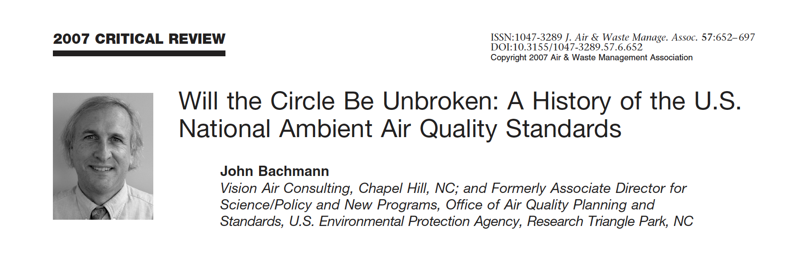
Air Quality Management 101+
2020: the 50th anniversary of Earth Day, EPA, and the Clean Air Act
A look at the the origins, development, evolution of U.S. AQM
  - Legislation, policies, and politics
  - A focus on National Ambient Air Quality Standards (NAAQS)
  - What worked and what didn’t in US Air Quality Management
  - A look at the latest in air pollution accountability science
  - What’s left? Continuing challenges for air quality management

Slide 3
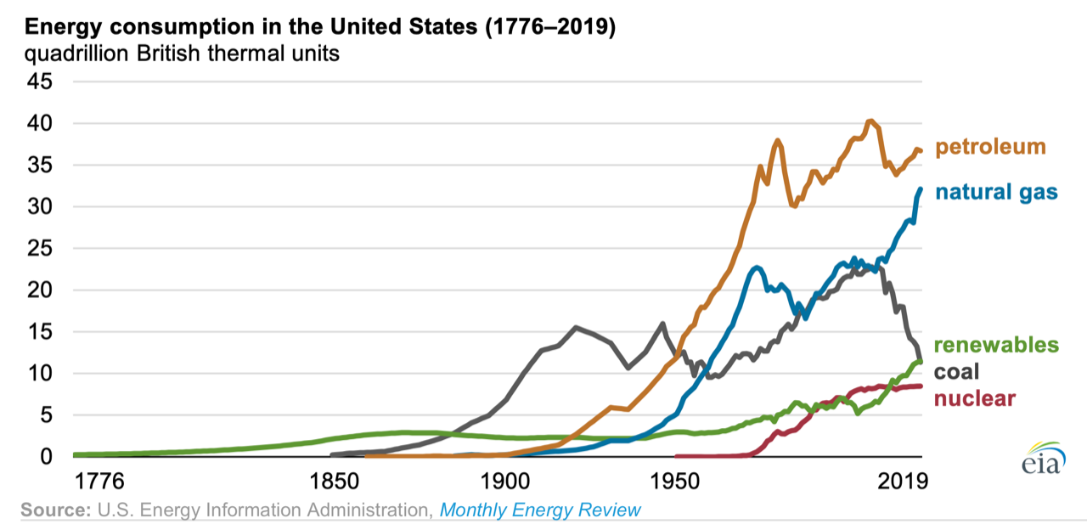
Strong growth of an industrializing country over nearly two centuries led to increasingly negative effects on our air, water, and land, with accompanying serious effects on people’s health and the environment.
Los Angeles
Donora
Pittsburgh
Notes:
The industrial revolution dramatically changed how society was organized
Rapid urbanization, population growth, big extractive industries and pollution – air/water/waste.
Coal use increased first - for industry and home heating
Post war petroleum marks the growth of automobiles and suburbs and new kinds of pollution. (why a dip in 1930s?)
A tale of 3 cities to explore some of these transformations click 1910 Pittsburgh, click nearby Donora PA in 1948 and click Los Angeles in the 1950s.
A BTU – energy 1lb of water 1 deg.
Quadrillion - 10e15

Slide 4
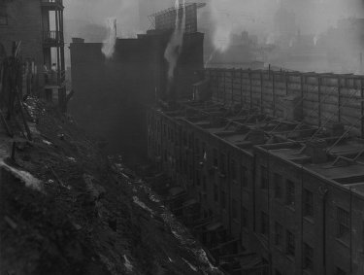
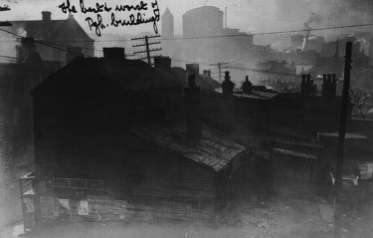
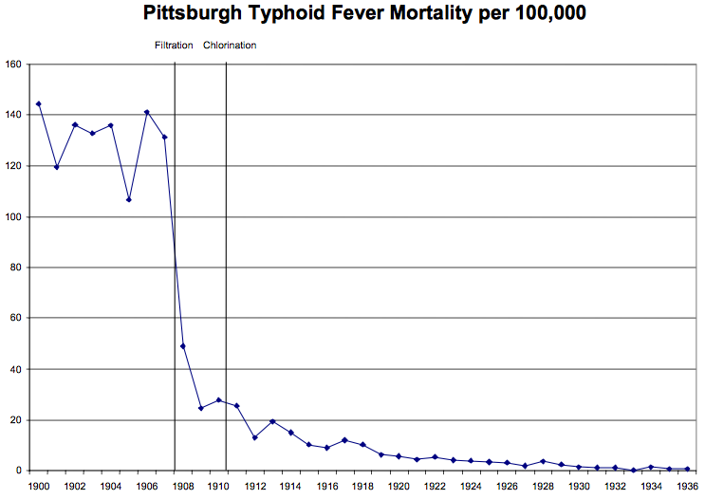
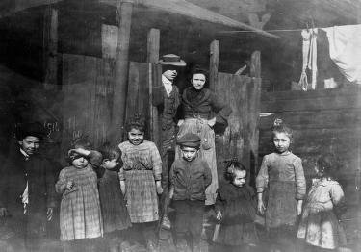
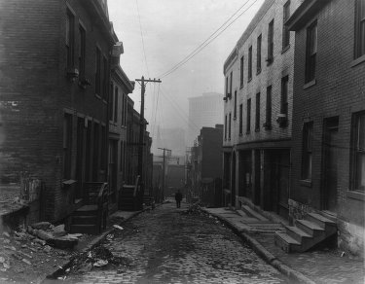
Pittsburgh 1906-1910
Typhoid Fever death rate
Early women’s movements for change followed by engineers – limited success
Notes:
Pittsburgh – the smoky city – miserable conditions
City authorities viewed it as a nuisance necessary for the economy, not a public health issue.
Early complaints - women’s groups click
Water supplies for a large crowded cities were polluted by wastes – Here, authorities took action to filter drinking water source - - dramatic reduction in deaths from Typhoid Fever.

Slide 5
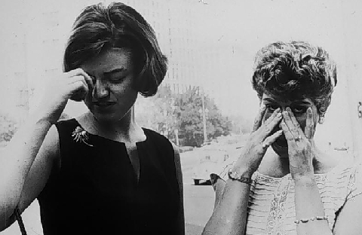
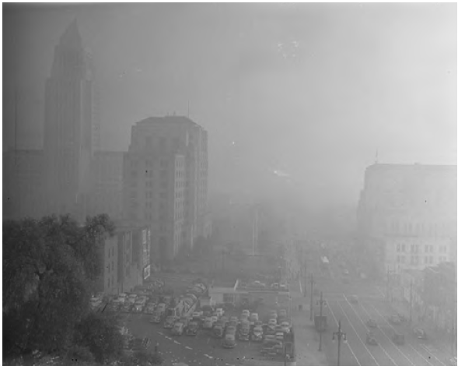
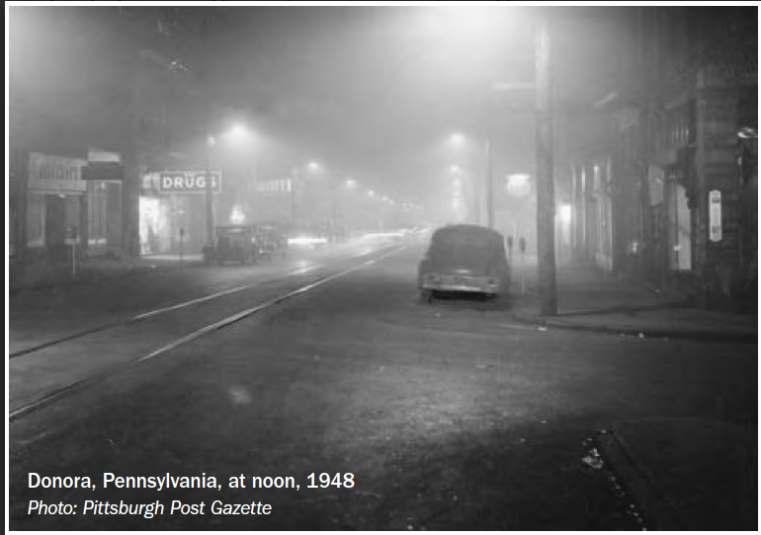
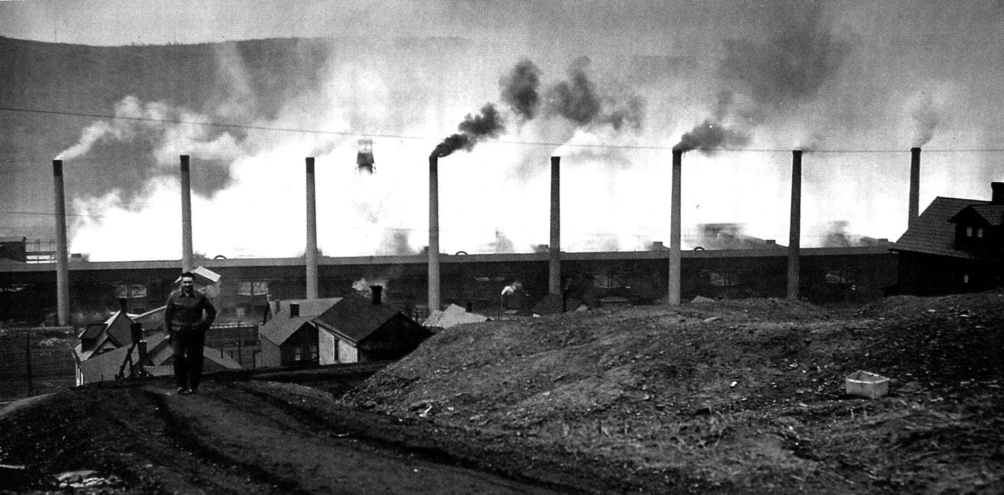
Los Angeles 1943-55
Donora PA 1948
Notes:
Donora - Small industrial town 40 miles from Pittsburgh
A typical day in 1948. Click
Donora at NOON during deadly smog
Foggy conditions created extreme episode (smog) of smoke and SO₂ that sickened 6000 people (40% of the population, and 20 died Click
1940’s -50’s LA a new kind of smog later found it was automobile emissions, Photochemical smog included “bad” ozone and other chemicals. Click
This smog irritated the eyes as well as the lungs.
These two events plus 1952 London killer smog
– Air pollution became a public health issue

Slide 6
US Air Pollution Programs in 1960
Cities maintained major air pollution responsibility
  84 municipalities had air programs, only 8 state programs*
  California dominated resources (60% of $10 million total city/state spending).
Federal involvement limited to modest research, monitoring, and state assistance programs
  PHS opposed federal involvement in air control programs
  New PHS Division of Air Pollution: 251 employees, $4 million
  National Air Sampling Network 60 urban, 20 nonurban particle (TSP) trends sites, many more non-trend sites

Slide 7

1960s: A growing environmental consciousness
“Only within the moment of time represented by the present century has one species -- man -- acquired significant power to alter the nature of the world. ”
Notes:
The 1960’s- events lead to growing national environmental awareness, culminating in demands for action
First 1962 publication of Rachel Carson’s book, Silent Spring,
She focused attention to pesticide effects on birds, more
Highlighted information on bioaccumulation of these persistent organic chemicals and their lasting effects far from application.
CBS Special on the book

Slide 8
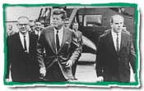
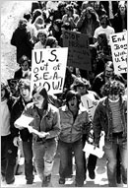
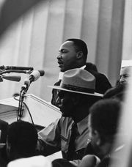
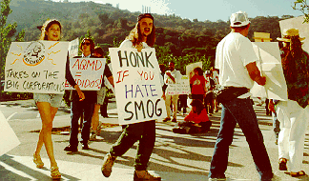
The 1960’s – who can remember?

Slide 9
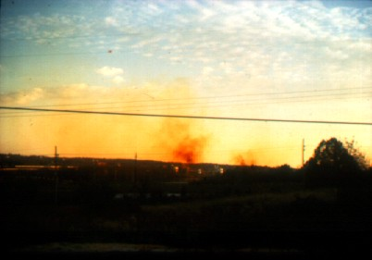
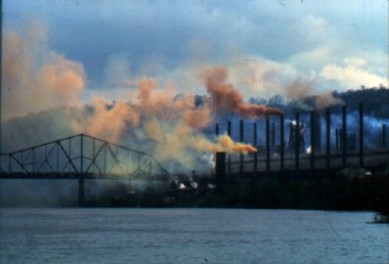
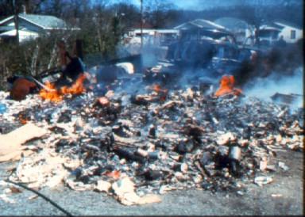
Bad scenes from the 60’s
Chattanooga munitions plant NOx
Steubenville Steel Mill
Burning dump
New York episode 1966
Notes:
– blasts from the past
– FYI the DC smoke is from a burning dump
\

Slide 10
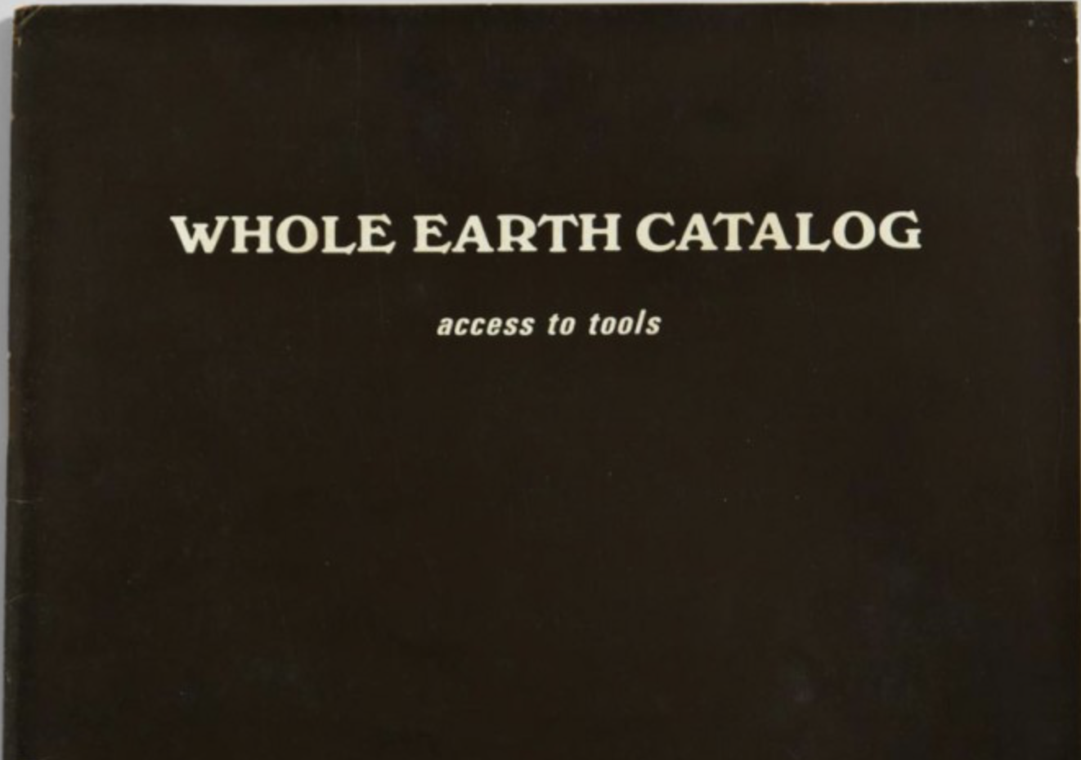

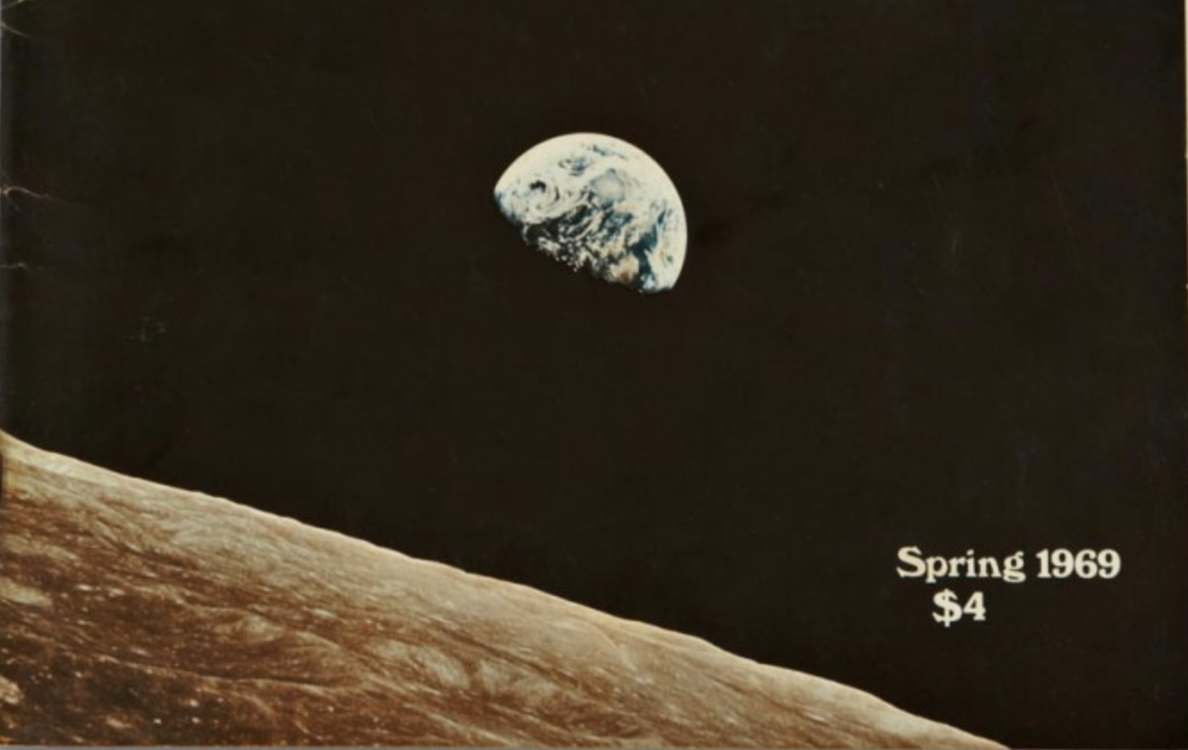
Meanwhile, from a distance…
Welcome! Sulfur dioxide
Hello! Carbon monoxide
The air, the air Is everywhere
Breath deep, while you sleep
Breath deep
Notes:
Left: This iconic picture of earthrise over the moon taken by Apollo astronauts gave many a new perspective of planet Earth
Right: Concern for the environment also appeared in popular culture through songs like Joni Mitchel’s Pave Paradise (Big Yellow Taxi) and this tune from Hair.

Slide 11
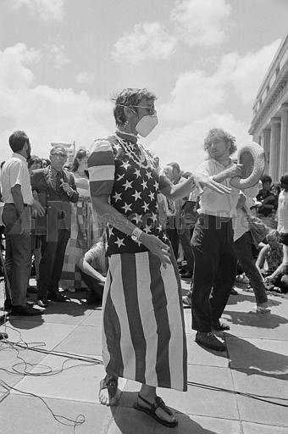
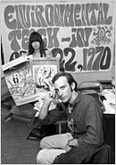
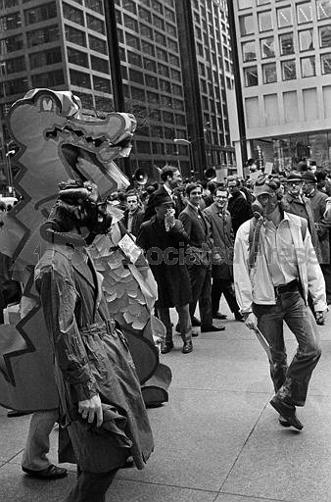
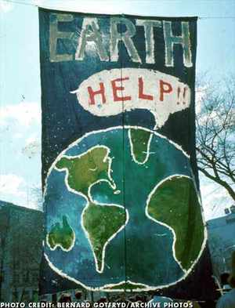
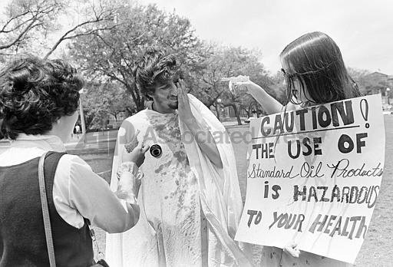
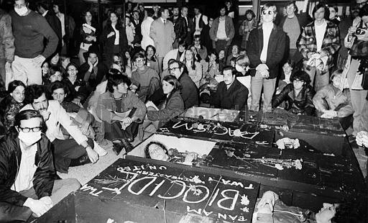
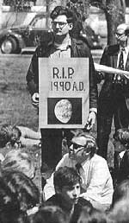
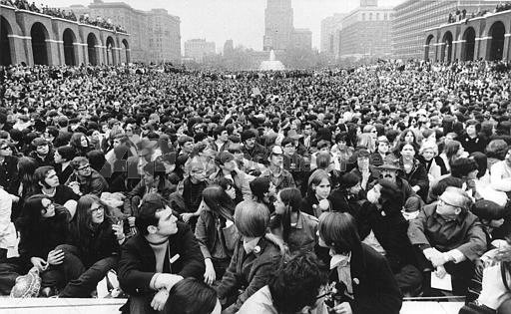
Earth Day April 22, 1970
20 million people participated in a national teach-in
Chicago
New Orleans
DC
New York
Miami
Boston
Philadelphia
Notes:
We’ve seen some big marches this year, but nationally and globally, none reached the participation in the first Earth Day
Politicians took even more notice!

Slide 12
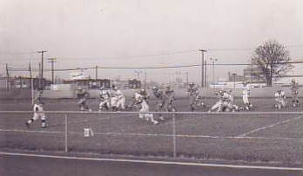
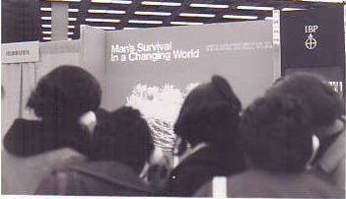
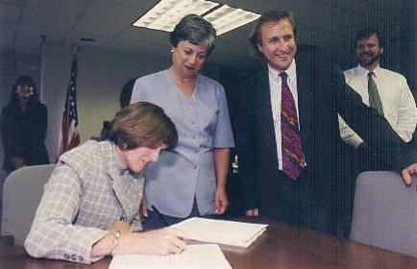
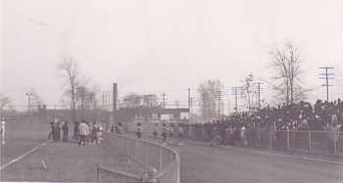
How Earth Day changed my career
Southwestern H.S. 1969
1st Earth Day 1970 , Detroit
1997 Carol Browner signs first PM_{2.5} rule
Notes:
This placeholder slide should be omitted or replaced with an illustration of your personal story on why you chose to work at EPA and/or something about your career – again, with or without a slide. In general it should go up front. If you have an earth day story, you could move the story later in the presentation as I've done here based on my earth day experience.
You should give a short bio to the teacher ahead of time so they can give students a sense of who’s coming to speak and what you’re going cover. This, before she asks them to each write a question or two to give you in advance for the Q and A.

Slide 13
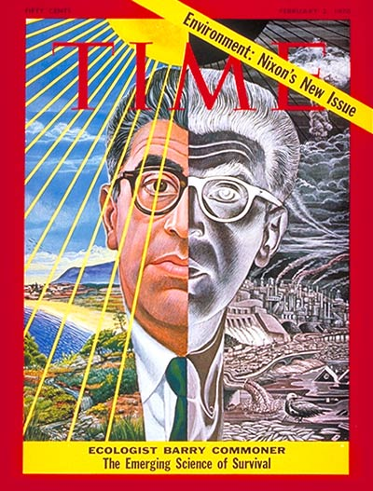
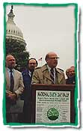
Astute politicians took notice early
Gaylord Nelson – Earth Day 1995 recalling his 1969 inspiration for the first Earth Day, a national “Teach-in” on the environment
February 2, 1970
Notes:
President Nixon was beset by protests against the Vietnam war –
But many of those same people were making the environment their cause as well –
The President and other politicians seized the opportunity to champion the cause

Slide 14
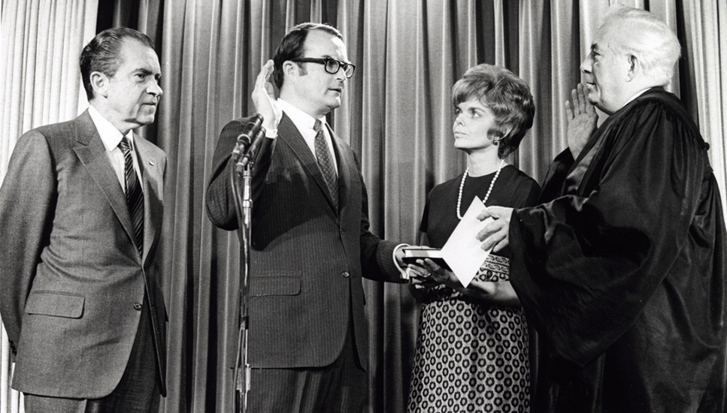
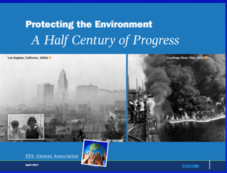
In 1963, 65, 67 new air pollution legislation, research and funding
In 1970 alone:
  National Environmental Policy Act (January 1)
  Environmental Quality Improvement Act (April 3)
  Environmental Protection Agency formed (Dec 2)
  Clean Air Act Amendments of 1970 (Dec 31)

Slide 15
Alternative Pollution Control Theories
Risk-based approach
  e.g. Air quality management based on health and environmental goals
  Emission limits based on residual risk
Technology-based approach
  e.g. ‘Best’ technology on all major source categories regardless of risk – (technology forcing?)
Market approaches
  e.g. Cap and trade, emissions taxes/fees
The U.S. system?
Notes:
This is perhaps a bit much for some H.S. classes - check with the teacher on overall length and depth. For air, some might want some fundamentals on primary vs. secondary emissions, and definition of criteria pollutants are and how they relate to NAAQS. In other cases, they've already covered this topic.

Slide 16
Air Quality Management - 1970
Establish Goals
Determine Emissions Reductions
States monitor, inventories, model reduction strategies
EPA sets science-based national standards (NAAQS)
Develop Programs to achieve
Track and Evaluate Results
Scientific Research
States develop implementation plans.
EPA reviews plans.
EPA sets technology-based national standards for vehicles, new major stationary sources, more
States monitor to see if standards are achieved
Implement and Enforce Strategies
The US approach is a Hybrid!
Sources comply with rules
States and EPA enforce
Notes:
Three ways to do this one - the full version has you spending time on each box. If you eliminate the animation but keep the language below each box, you might save a bit of time, but just showing the box without the underbox details is faster.

Slide 17
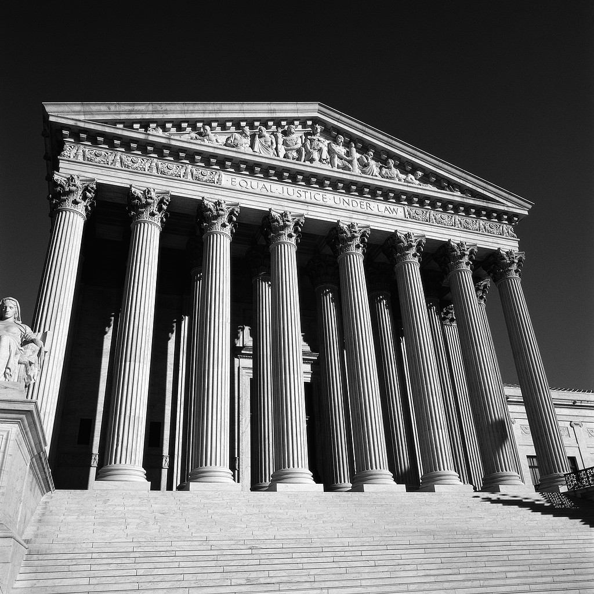

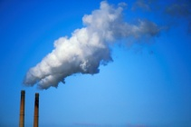

Key players in AQM and the NAAQS
The executive Branch
The Courts
EPA CEQ OMB
Congress
Other Federal Agencies
DOE, DOC, DOT, DOI,,USDA
DOD, NOAA, NASA,
Major Industry,
Trade organizations
Air Quality Management
Other Nations
Small Businesses
Agriculture
Scientists, engineers, academia, research organizations
Clean Air Scientific Advisory Committee (CASAC)
State Governors
County Officials
Mayors
City Council Members
State Legislators
The public at large
  Educated/environmentally interested
  Consumers, Students
State/Local Air Agencies
Environmental and Public Health Groups
EPA Regional Offices

Slide 18
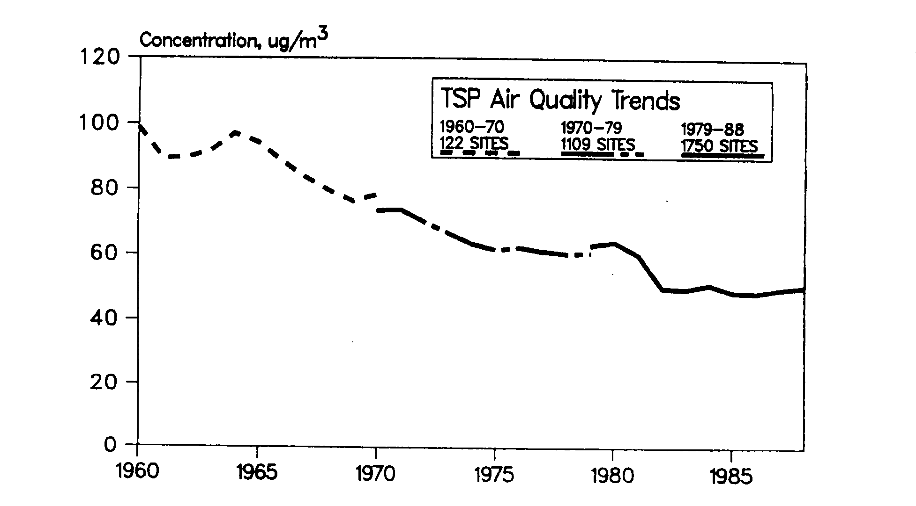
Results: Urban TSP Trends 1960-88
Little progress 1961-66
Continuous progress 1966-77
Decline after 1971 dominated by areas not meeting NAAQS
Filter medium change
TSP SIPS on hold during PM NAAQS review
Notes:
Note the small numbers of sites early and how they grow - also Total Suspended Particles includes a fair amount of large particles.

Slide 19
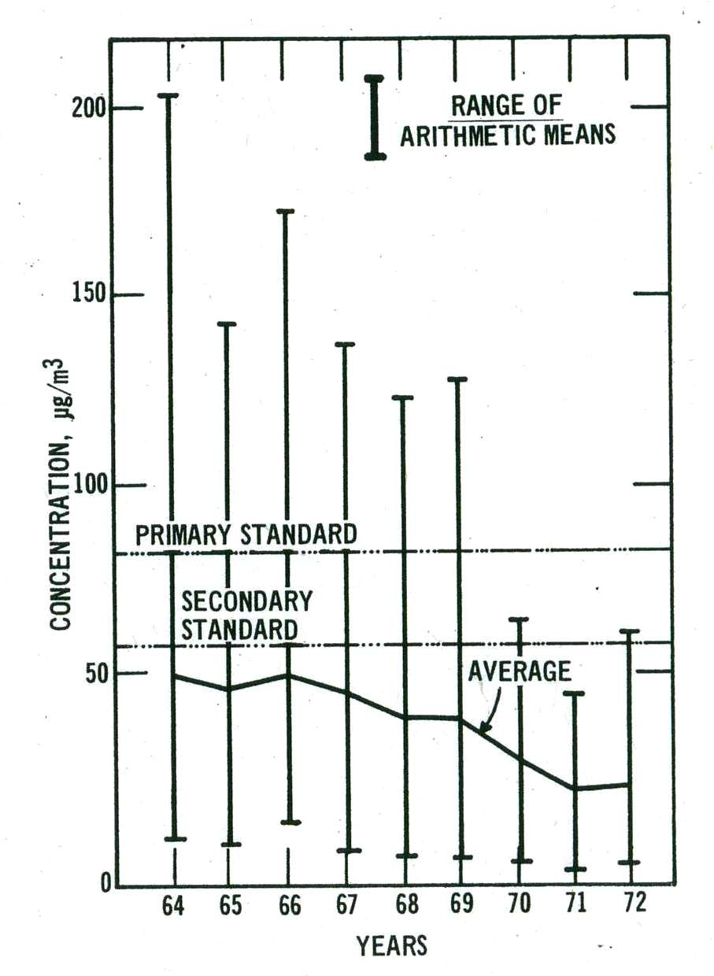
SO₂ Trends
  32 NASN urban sites
  Improvements begin in 67, accelerate 69-71
  This suggests 1963 Interstate studies, 1967 CAA AQM requirements produced results, continuing after the 1970 amendments
Notes:
Very few of these sites, many of them in large eastern cities. This sets up an early mystery

Slide 20
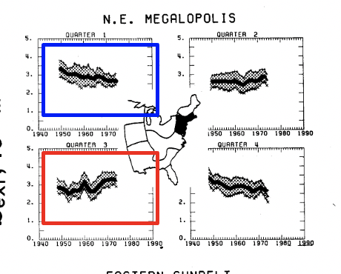
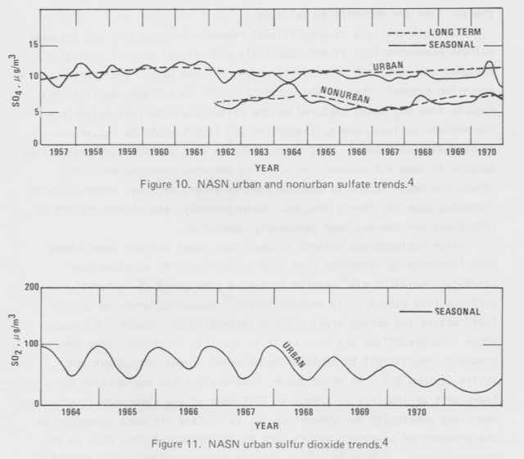
But what’s up about acid sulfate particle trends?
While SO₂ gas urban levels declined after 1968….
Sulfate particles formed from SO_{x} emission increased in urban and non-urban areas
Analysis of airport visibility indicated fine particles decreased in winter and increased in summer!
Extinction (inverse visibility) 1948-75
Trends in sulfate particles vs SO₂ gas
Notes:
This posed a question when we first noticed the difference. This gives you a chance to explain that SO2 presents more than meets the eye - in addition to being an irritant gas linked to health effects, it transforms into acid sulfate particles (sulfuric acid, and ammonium sulfates (two kinds). These contribute to fine particle exposures over wide regions of the East.
The airport visibility indicator is light extinction (bext). At higher fine particle levels extinction increases and visibility decreases. In parts of the greater northeast this indicator shows fine particles in the wintertime decreased in the 60's to 70s in response to fuel switching and programs to control direct sources. But in summer visibility began to decrease from higher regional levels of fine particle sulfates.
The next slide shows the trends for total SO2 increases - while urban emissions decreased, utilities were building more coal fired power plants in non-urban areas and also meeting SO2 standards by building tall stacks, that reduced SO2 locally but contributed to long-range transport of SO2 and sulfate particles formed from it.
Be sure to note that this phenomenon was finally recognized as a major contributor to the growing acid rain observed in the east - NOx emissions from power plants and cars were a part of that.

Slide 21
National SO₂ and NOx trends
US enters WWII
1970 CAAA
Notes:
See the HCP report Cleaning the Air We Breathe for some of this story -
It is a key reason a Federal role for addressing air pollution was needed as these two pollutants were increasing over time throughout the 1960's due to more power plants and cars. Only measures included in the Clean Air Act of 1970, i.e. mobile source rules for NOx and increased controls on new powerplants and industry as well as the NAAQS began to turn both trends around in the mid 1970s.

Slide 22
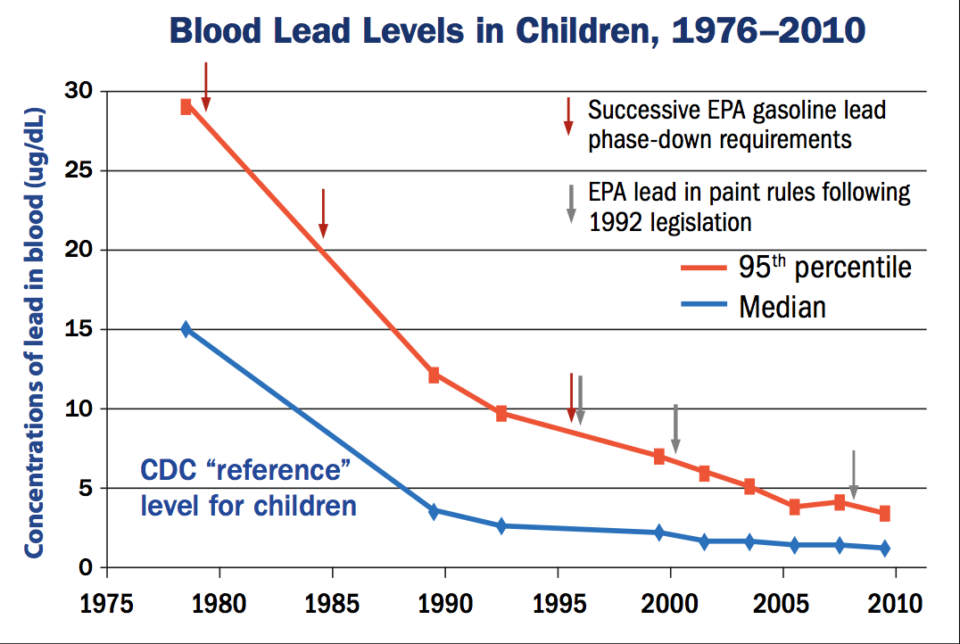
Notes:
This slide focuses on the successive reductions in lead in gasoline, in part because lead poisoned automotive catalysts controls and in part because of lead health effects.
Note - most exposed (95th%tiles) vs. Median
The arrows show EPA gas and paint rules
MAJOR DECREASE IN BLOOD LEAD LEVELS IN CHILDREN BEGUN BY SUCCESSIVE EPA REGULATIONS TO REDUCE LEAD IN GASOLINE (Clean Air Act)
Note the trend is CONTINUED BY EPA RULES THAT REDUCED LEAD IN PAINT (TSCA).
Infants and young children are especially sensitive to even low levels of lead, which may contribute to behavioral problems, learning deficits and lowered IQ.

Slide 23
Los Angeles Smog levels
Days above 2008 Ozone standard (0.75 ppm)*
Maximum 8-hour ozone concentration trend
Notes:
LA had the worst photochemical smog in the nation, but tremendous progress due to the introduction of automotive catalysts in new cars (1976 on)
Also Continuous actions taken by California and the South Coast Air Basin over decades
California rules and amendments to the Clean Air Act (1977, 1990) , new EPA regs resulted in tighter car and truck emissions limits nationwide
This chart from the South Coast shows levels relative to EPA's 2008 standard of 0.75 ppm. The current standard is 0.70 ppm. The South Coast has never met the national standards, but these programs brought health benefits by the continuing reductions over the years.

Slide 24
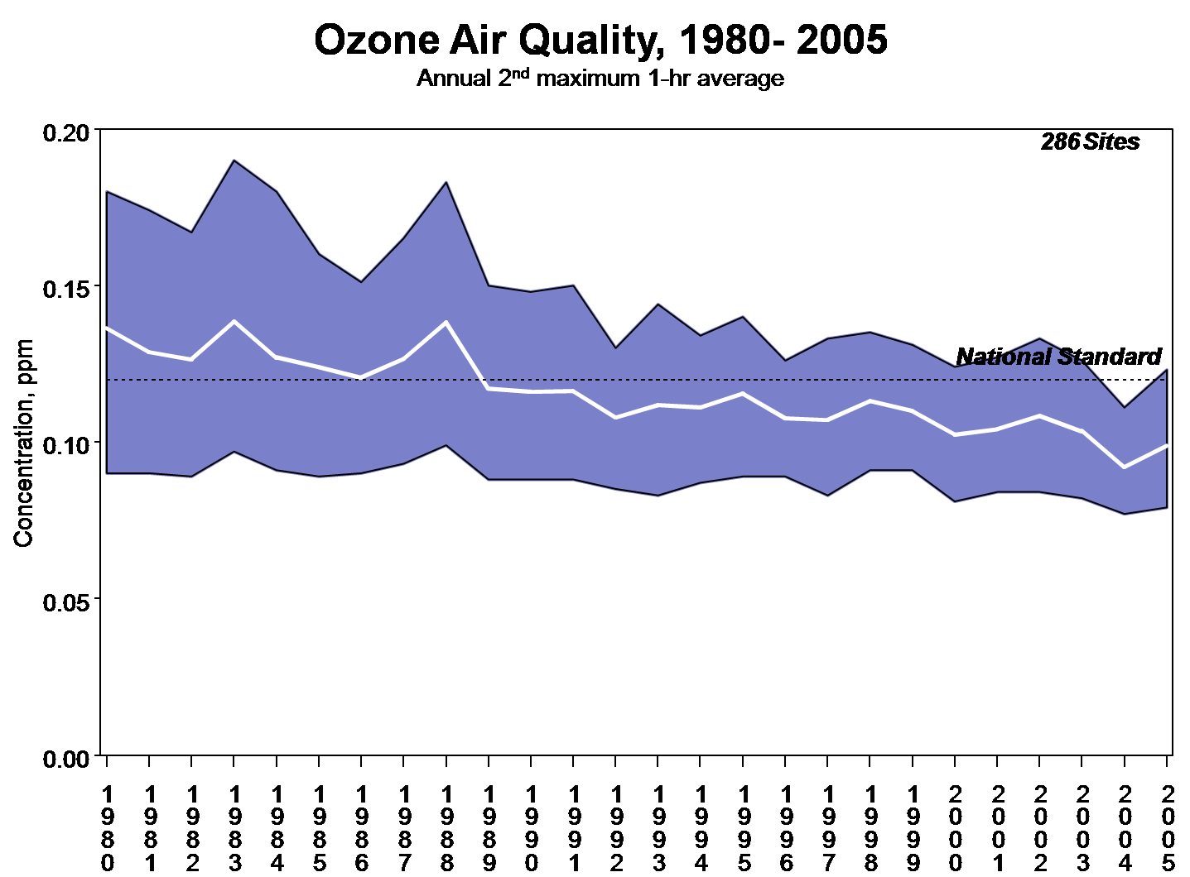
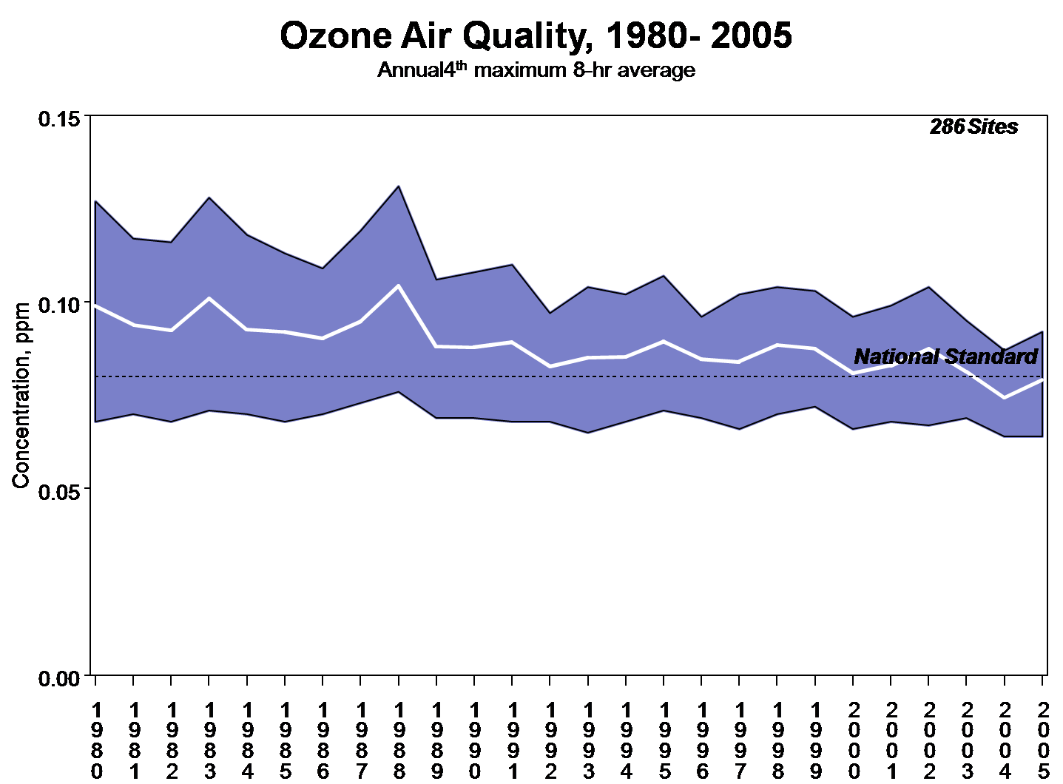
1988 peak
ff
1988 peak a stimulus for 1990 Amendments
From a 1989-90 perspective, AQM was not working for smog
Trends based on
1997 Updated 8-hr ozone NAAQS
By 1990; 100 areas did not meet the 1-hour standard
Notes:
Here's where a problem in ozone implementation began to appear -
National averages (white line) and 95th percentiles above and below are shown. While there is an overall slow decline, progress began to slow, and some of the highest levels in the Eastern US occurred in the summer 1988, where even the Smoky Mountains were well above the NAAQS.
In the end we learned this was due to an inadequate understanding of the cause of high levels of summertime ozone in the Eastern U.S. In the end analyses and modeling indicated that over that large region, high biogenic (vegetation) emissions of volatile organic chemicals meant that the focus on controls on anthropogenic VOCs may work in some urban areas, but not across the region. It was necessary to reduce NOx emissions from power plants and vehicles -
A hard look at other issues contributing to a lack of progress was a major impetus for amending the clean air act.

Slide 25
An interim scorecard 1980-1994
Unfinished business:
  Acid rain - regional scale SO_{x} and NO_{x} emissions
  Ozone - Rethinking- regional scale NO_{x} and biogenic VOC
    New science suggests stronger standards
  PM – New fine particle health science
    Regional scale SO_{x}, NO_{x}, diesel emissions
Impetus for the 1990 Clean Air Act amendments
Notes:
Here are three major drivers for changes in the 1990 CAAA. A fourth was addressing hazardous air pollutants.
A key point is that monitoring, improved scientific information on air pollution formation, and increased understanding of the pollutants most responsible for health effects drove both changes in the Clean Air Act in 1990, and eventually changes in the National Ambient Air Quality standards for particulate matter and ozone in 1997.

Slide 26
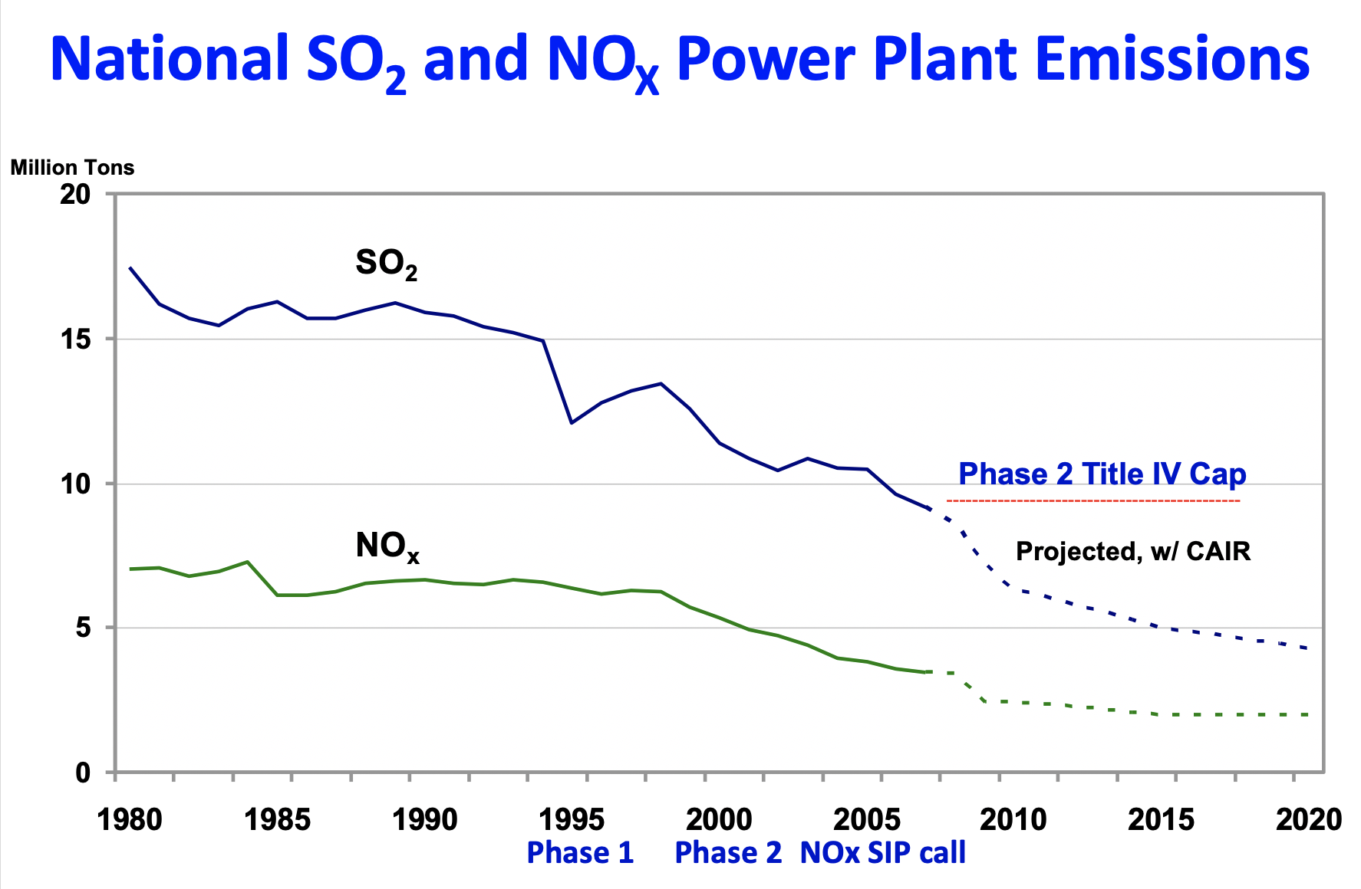
AQM since the 1990 Amendments
Acid Rain Implementation
The NAAQS reviews
  Tightening O₃, PM
NAAQS Implementation
  O₃ policy catches up with science, new PM_{2.5} needs
  New mobile regs, regional strategies
Pressure on power generation
Air Toxics

Slide 27
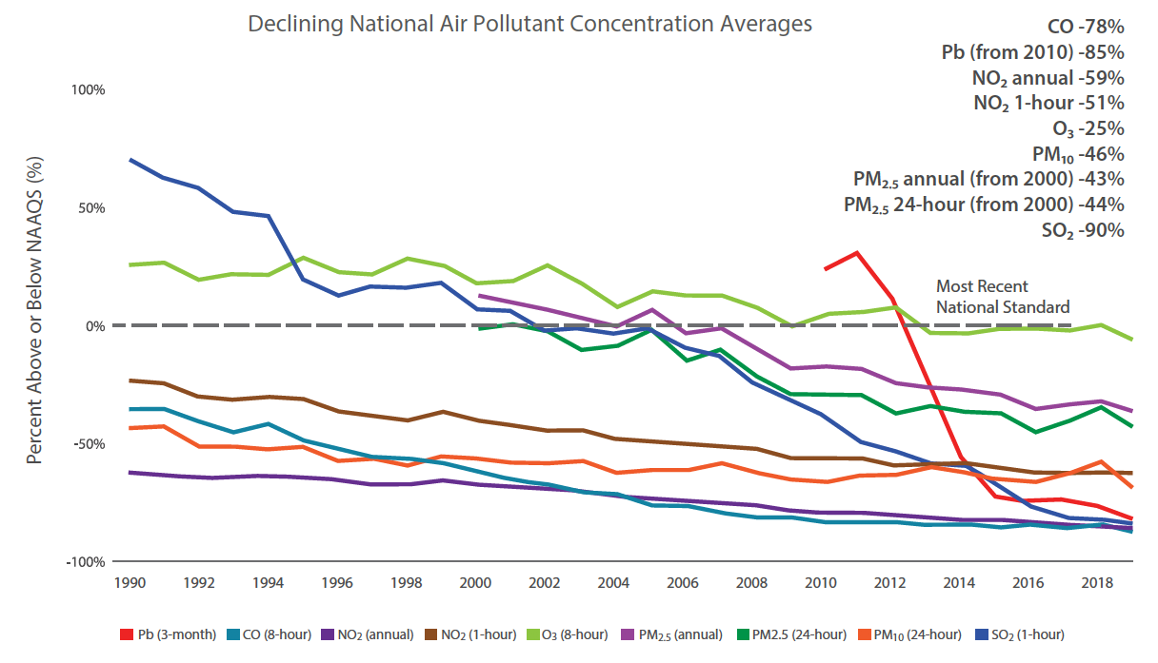
Criteria pollutants continue to improve
8-hr Ozone trends
PM_{2.5} annual
PM_{2.5} daily

Slide 28

A Clean Air Success Story – benefits, costs, and growth
Cumulative benefits 1970-90
$6 to $50 trillion
Cumulative costs - $ 520 billion
Projected annual benefits 2020
$2 trillion/yr
Annual costs - $65 billion/yr
Notes:
Note the scale change, focus on ’the bottom line” six pollutant reductions since 1970
Note also that Clean air legislation did not stop growth in CO2 emissions, which began to decline only in 2008
Recent details – the 1988 recession caused dips in drivers of CO2 emissions

Slide 29


Accountability Science
A massive health study using multiple advanced
causal inference methods to assess the benefits of
Reducing fine particles
“we conclude that long-term PM_{2.5} exposure is causally related to mortality”
The effects estimates are in the range of those found
in past EPA Benefit-cost assessments using multiple
cohort studies.

Slide 30
Major pollutants continue to decrease
But….
10s of thousands of premature deaths/yr remain in the US
Standards should be strengthened
8-hr Ozone trends
Environmental justice – minorities 75% more likely to live near oil and gas facilities, chemical plants
PM_{2.5} annual
PM_{2.5} daily

Slide 31



Despite progress, major challenges remain
San Francisco Sept 2020
Continued improvements to maintain and increase the benefits achieved so far, and ensure they are distributed fairly to all Americans
International transport/Global Burden
Climate change
  Drought/fires and PM_{2.5} are already here
  Warming induced stagnation and other effects increase ozone
  Climate strategies benefit air quality
Los Angeles Oct 2019

